Slide 1

Ibm data science capstone
BATTLE OF THE NEIGHBORHOODS
SARAH BINSADDIK

Slide 2
Introduction
With a population of 7.3 millions, Riyadh is the capital of Saudi Arabia and the largest city on the Arabian Peninsula. Riyadh is becoming a leading and an attractive city for tourists and entrepreneurs.
Having a big city like Riyadh, We are aiming to find the best neighbourhood to open a shop specialized in desserts and unique coffee.
So we are choosing two neighborhoods in the capital of saudi Arabia where hundreds, even thousands of people visit everyday.
This report can help entrepreneurs who are looking to open a coffee shop near one of two largest Universities in Riyadh, Saudi Arabia.

Slide 3

Data
I’ll be using the Foursquare API to explore the nearby venues for both King Saud University (KSU) and Imam Mohammed Ibn Saud University( IMAMU) in order to find the most accurate place to open the Shop. I looked for venues up to 4 KM range from the latitude and longitude of both universities.

Slide 4

Methodology:
Choosing the main locations
Creating a foursquare developer account
Exploring the nearby venues within a specific radius.
Visualizing the unique venue categories within the area.

Slide 5
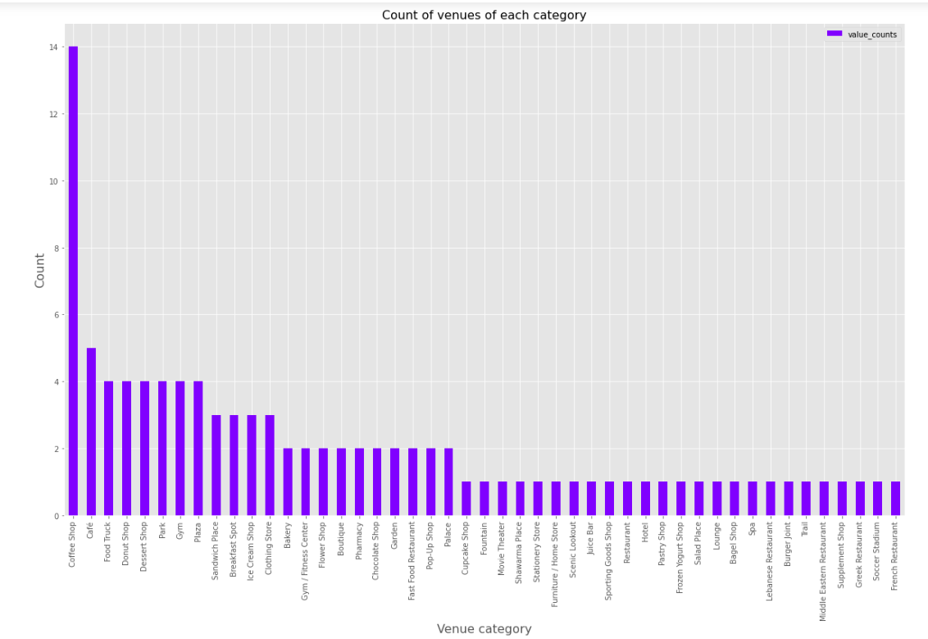
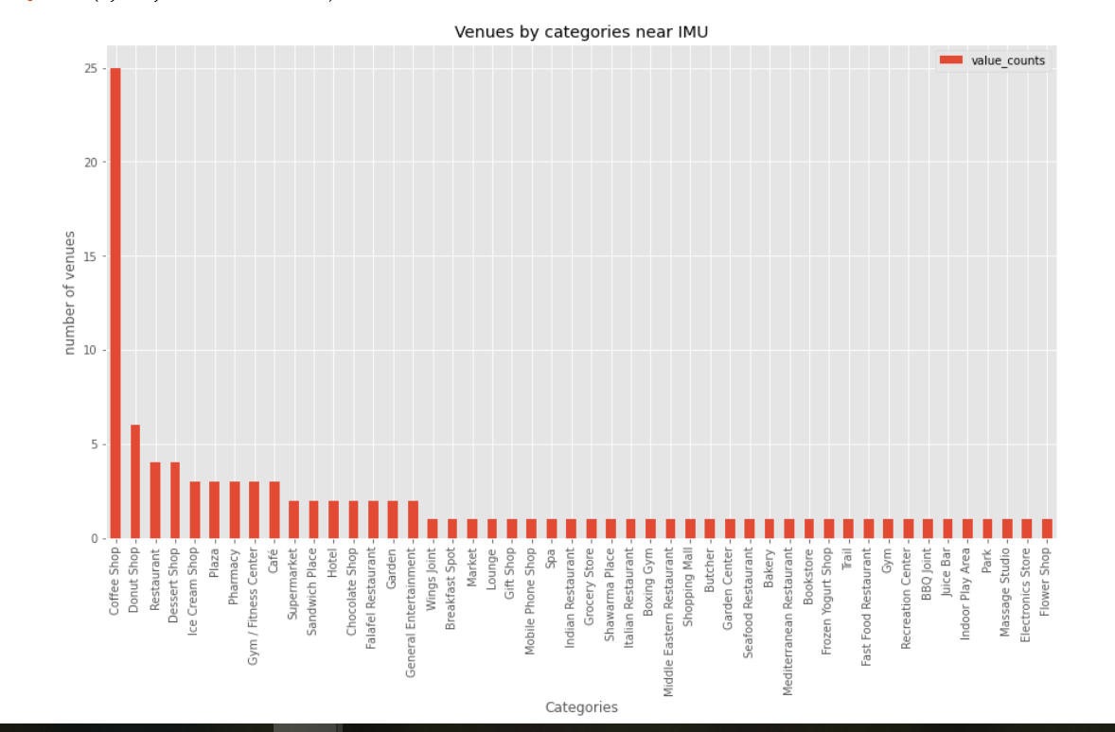
Results:
King Saud University
Imam Mohammed Ibn Saud University

Slide 6
After filtering the categories and grouping the dessert shops together. We can see both neighborhoods have a high number of coffee shops, but we can say that opening a shop specialized in coffee and dessert in the first neighborhood ( Near King Saud University ) might be the better option that’s because, Imam University has almost 10 more coffee shops. Although both neighborhoods have the same number of dessert shops.

Slide 7
Conclusion
We have applied some simple comparison techniques to see the better place to open a shop specialized in coffee and desserts , but there is always a place for improvement and taking more factors in consideration such as, rates, prices and tips.

Slide 8

RESOURCES
https://www.4icu.org/sa/riyadh/
https://ksu.edu.sa/en/about-ksu

Slide 9

THANK YOU
SARAH BIN SADDIK

